Slide 1
PROJECT REPORT on Flight Price Prediction project
By Sreekari I

Slide 2
Overview
Business Objective
01
Data Exploration
02
Data Preprocessing
03
Modeling
04
Conclusions
05

Slide 3
Business Objective

Slide 4
Business Objective
INTRODUCTION:
Anyone who has booked a flight ticket knows how unexpectedly the prices vary. The cheapest available ticket on a given flight gets more and less expensive over time. This usually happens as an attempt to maximize revenue based on –
1. Time of purchase patterns (making sure last-minute purchases are expensive)
2. Keeping the flight as full as they want it (raising prices on a flight which is filling up in order to reduce sale
OBJECTIVE:
To make a flight ticket price valuation model to predict the ticket price.

Slide 5
Data Exploration

Slide 6
Exploration - Overall
Data source
Data is collected from https://www.makemytrip.com website. The details include the various features of the flight that are helpful to predict the price of the ticket.
Data Exploration
Shape of dataset (7990 rows, 9 columns) -[before removing Unnamed :o column]
Observation:
There are no null values in the dataset.
Shape of dataset –[after removing the null values and columns that are not useful in model creation]
7990 rows, 8 columns

Slide 7
Dataset Variables
There are 8 columns of object datatype and one column of int64 datatype.
Datatype Object
'Name', 'Price', 'Departure time', 'Arrival time’, 'Departure Place', 'Arrival Place', 'Duration', 'Flight type’
Datatype int64
'Unnamed: 0'

Slide 8
Data Pre-Processing

Slide 9
To proceed further, I have converted 'Departure time', 'Arrival time', 'Duration' to timestamps and these new columns that I have created were added to the dataset.
-→ Removing the columns that are not useful.
I have removed the ‘Unnamed: 0’ column since it is not useful in creating the model. Also I have dropped 'Departure time', 'Arrival time', 'Duration' columns as I have created timestamps for the required info from these columns

Slide 10
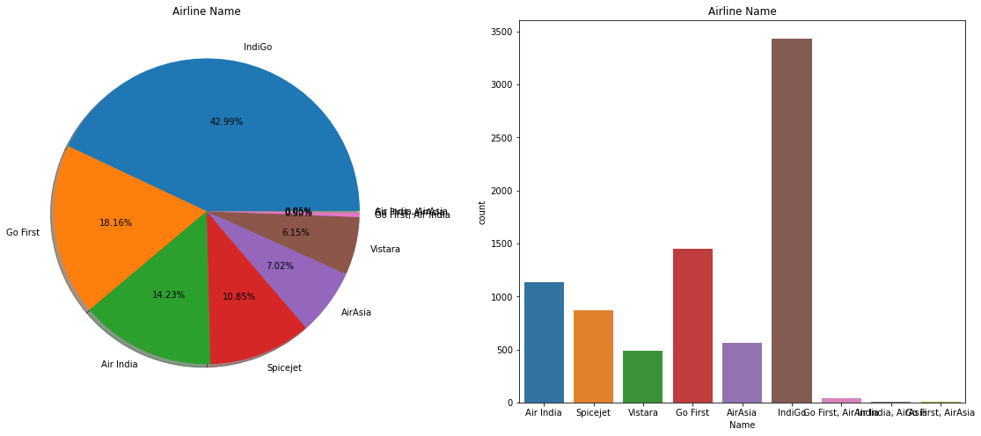
The below image is the pie chart and count plot showing the Airline Name column distribution

Slide 11
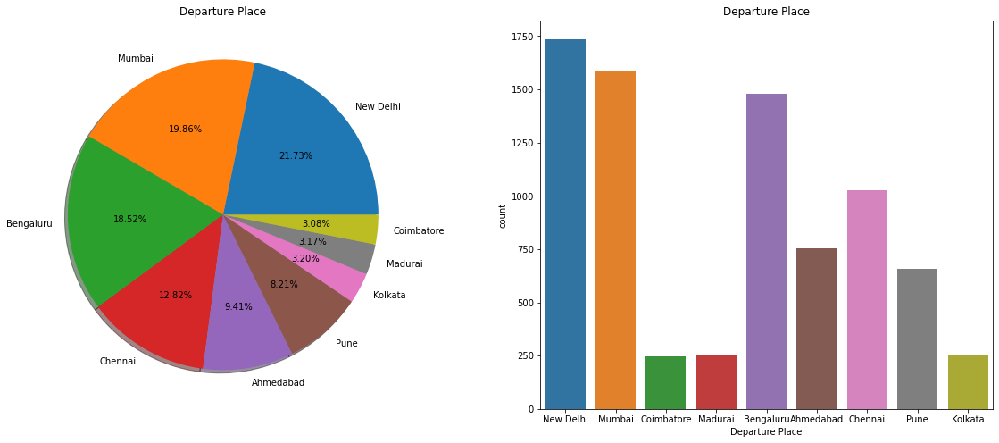
The below image is the pie chart and count plot showing the various Departure places of the flights

Slide 12
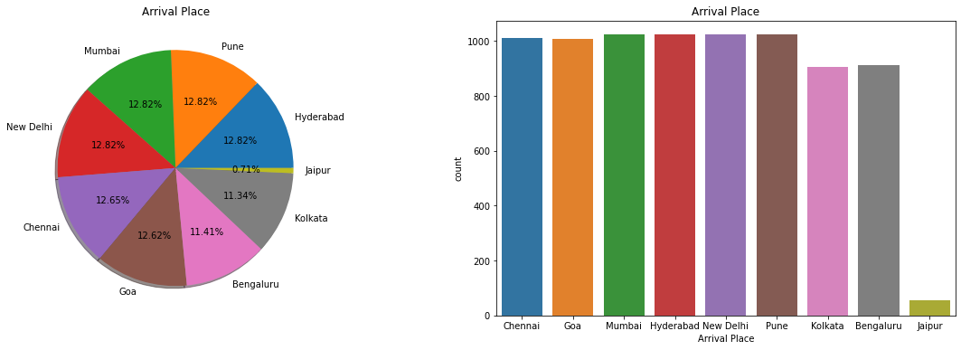
The below image is the pie chart and count plot showing the various Arrival places of the flights

Slide 13
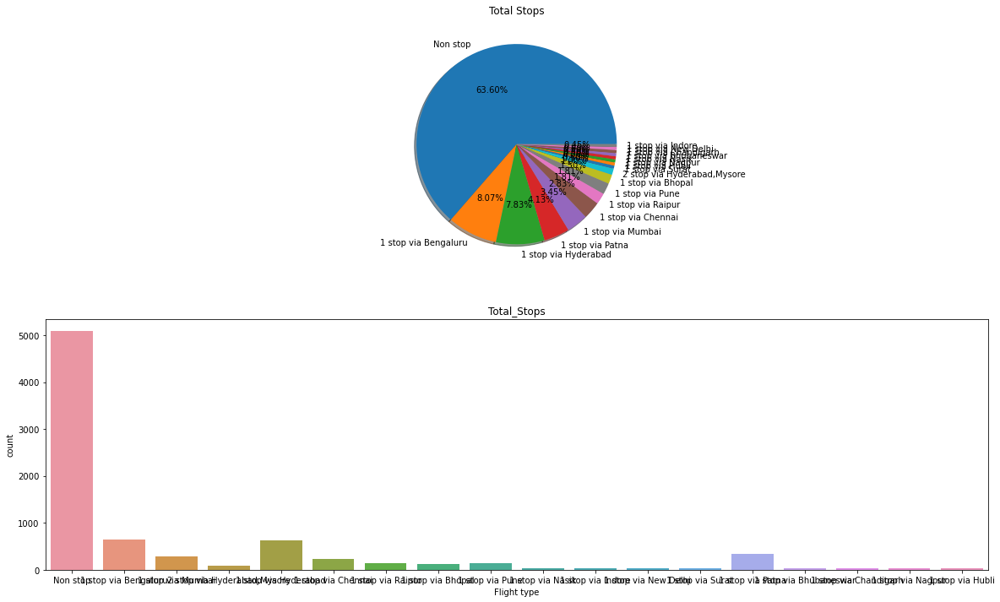
From the below images, we can see that most of the flights are Non stop.

Slide 14
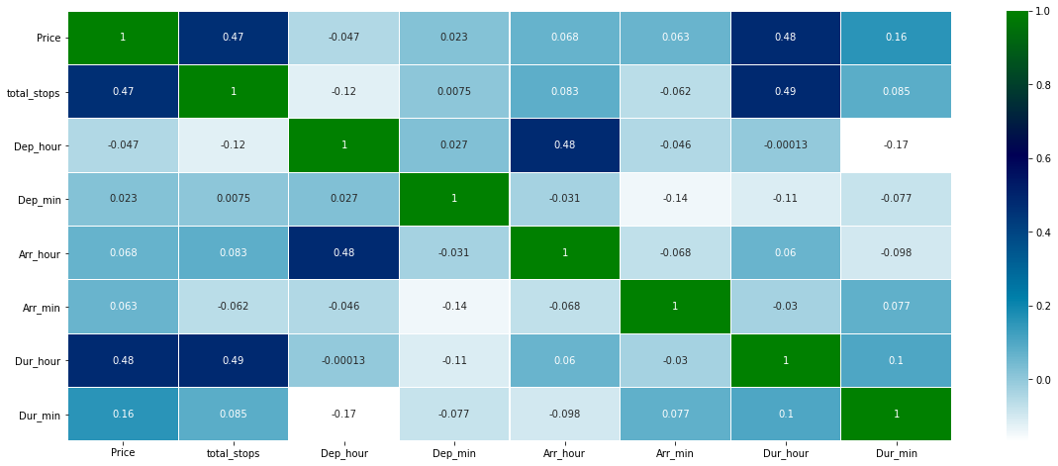
Later, I have encoded the categorical data to create data model. After all the above steps the dataset now have 7990 rows and 33 columns. The below image is the heat map. We can see the correlation between the columns of the dataset with this heat map.

Slide 15
Model Creation
Firstly, divide the data into X and y sets for the model building. Next, splitting the data into training and test data test.
Next, split the data into training and test data test. We specify this so that the train and test data set always have the same rows, respectively.
Now, we can move to building the models. I have used linear regression model and random forest model and applied hyper parameter tuning using Randomized search cv on random forest model.

Slide 16
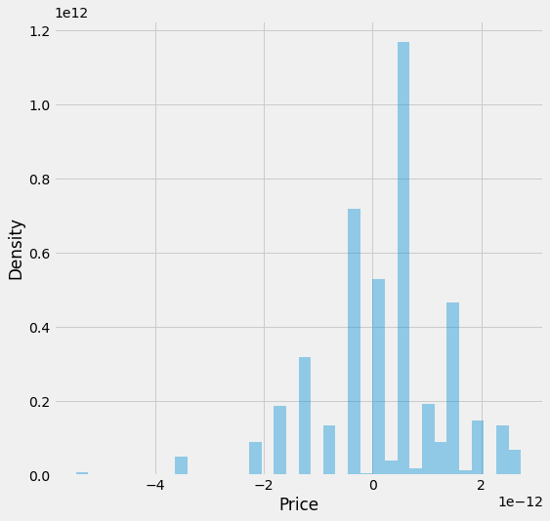
LINEAR REGRESSION MODEL
Accuracy is 96.68335419274092..
MAE: 8.92704905964229e-13
MSE: 1.3635798051425615e-24
RMSE: 1.1677241990909331e-12
Variance score: 1.0

Slide 17
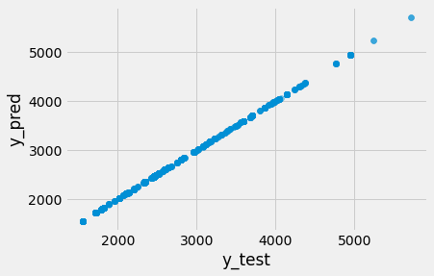
RANDOM FOREST MODEL
RandomForestRegressor Score: 0.9999998585639498Grid
MAE: 0.08637672090112625
MSE: 0.9066258448060094
RMSE: 0.9521690211333329

Slide 18
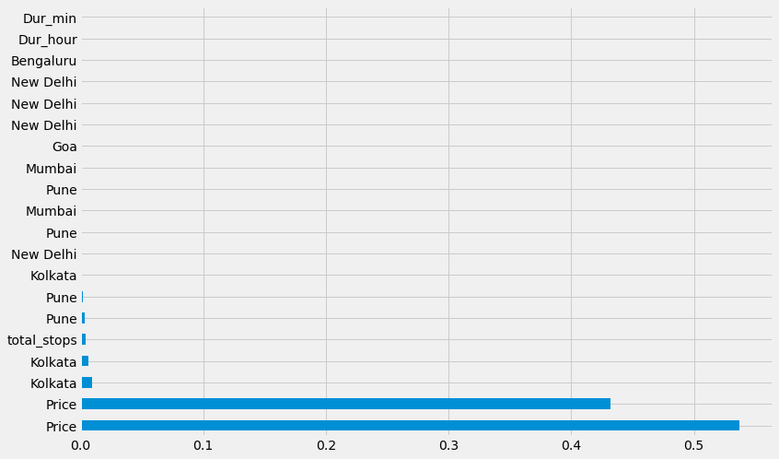
Feature importances for better visualization

Slide 19
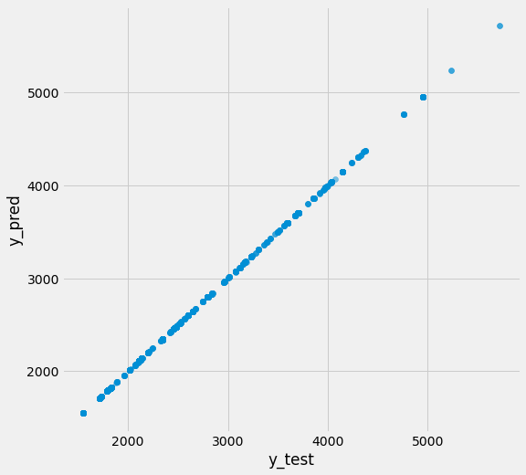
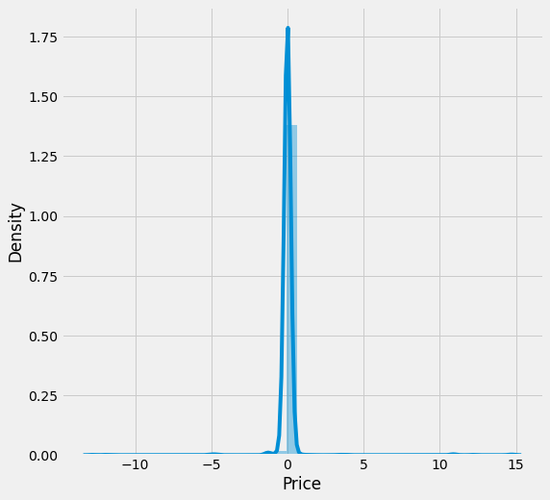
Hyper Parameter Tuning
MAE: 0.0973402805559119
MSE: 0.8691632192061807
RMSE: 0.9322892358094567

Slide 20
CONCLUSION
From the above analysis we can see that various features of the flights affect the ticket price of the flights. If it has less stops and less duration of travel, the price of the ticket will be more when compared to the flight with more number of stops. The price will also be affected based on the distance of travel also. So the flight ticket price can be predicted based on these factors.

Slide 21
THANK YOU..!!!

